Slide 1
EXECUTIVE FUNCTIONS AND EARLY CHILD DEVELOPMENT
Cesar Ochoa, MD, MPH
Developmental-Behavioral Pediatrics Division Chief
Associate Professor of Pediatrics
Rush University Medical Center
10/1/2021

Slide 2
LEARNING OBJECTIVES
Review the current understanding of the science of child development
Explain the role of epigenetics and its lifelong impact on developmental trajectories
Define the concepts and components of executive function skills and their impact on child development
Describe the milestones and development of executive functions in early childhood
Apply early childhood interventions to promote executive function skills in young children and improve long term developmental outcomes

Slide 3
DISCLOSURE
This powerpoint presentation is based on material from the Center on Child Development website - www.developingchild.harvard.edu

Slide 4
THE SCIENCE OF EARLY CHILDHOOD DEVELOPMENT
Center on the Developing Child (2007). The Science of Early Childhood Development. Retrieved from www.developingchild.harvard.edu.

Slide 5
Brains are built over time, from the bottom up
Basic architecture of the brain: ongoing process, from before birth into adulthood.
Early experiences affect quality of architecture: either a sturdy or a fragile foundation for health, learning, and behavior
First few years of life, more than 1 million new neural connections are formed every second. After, connections reduced through pruning → brain circuits become more specialized and efficient.
1 – Sensory pathways like for basic vision and hearing
2 - Language skills
3 - Higher cognitive functions

Slide 6
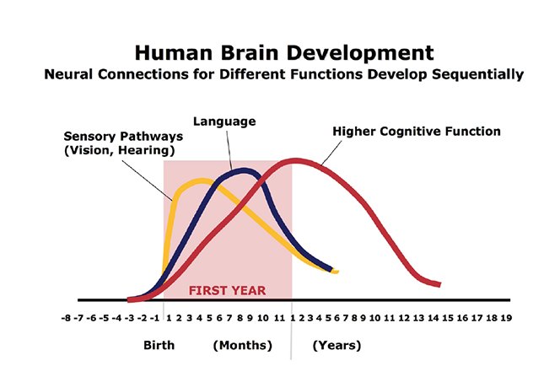

Slide 7
The interactive influences of genes and experience shape the developing brain.
“Serve and return” relationship between children and their parents and other caregivers in the family or community.
Young children naturally reach out for interaction:
Vocalizations
Facial expressions
Gestures
Adults respond to children
In the absence of such responses—or if the responses are unreliable or inappropriate—the brain’s architecture does not form as expected, which can lead to disparities in learning and behavior.
Notes:
Serve and return works like a game of tennis or volleyball between child and caregiver. The child “serves” by reaching out for interaction—with eye contact, facial expressions, gestures, babbling, or touch. A responsive caregiver will “return the serve” by speaking back, playing peekaboo, or sharing a toy or a laugh.

Slide 8
Brain’s capacity for change decreases with age
The brain is most flexible, or plastic, early in life to accommodate a wide range of environments and interactions
As the maturing brain becomes more specialized to assume more complex functions, it is less capable of reorganizing and adapting to new or unexpected challenges.
For example, by the first year, the parts of the brain that differentiate sound are becoming specialized to the mother tongue; at the same time, the brain starts losing the ability to recognize different sounds found in other languages.
“Windows” for language learning and other skills remain open, but these brain circuits become increasingly difficult to alter over time.
Because of early plasticity it is easier and more effective to influence a baby’s developing brain architecture than to rewire parts of its circuitry in the adult years. “A stich in time saves nine.”

Slide 9
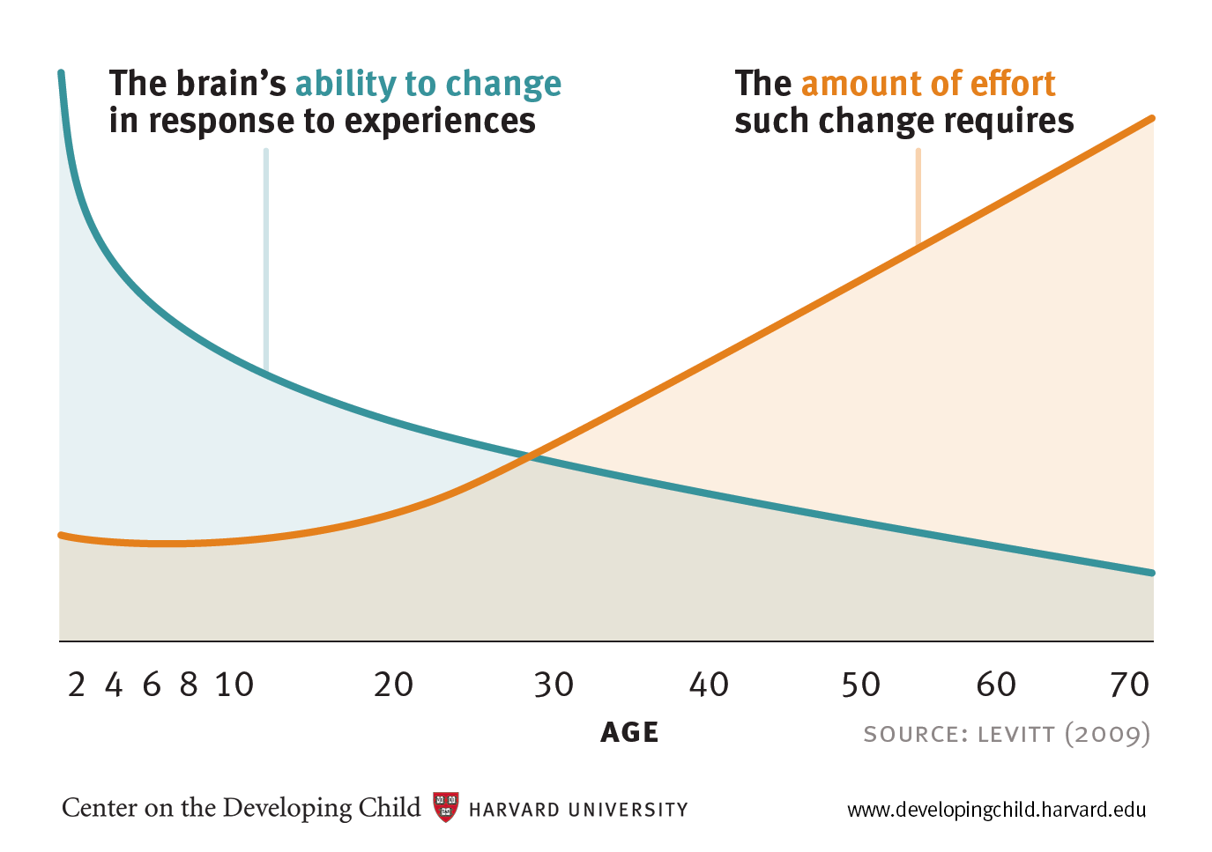

Slide 10
Cognitive, emotional, and social capacities are inextricably intertwined throughout the life course
The brain is a highly interrelated organ, and its multiple functions operate in a richly coordinated fashion.
Emotional well-being and social competence provide a strong foundation for emerging cognitive abilities, and together they are the bricks and mortar that comprise the foundation of human development.
The emotional and physical health, social skills, and cognitive-linguistic capacities that emerge in the early years are all important prerequisites for success in school and later in the workplace and community.

Slide 11
Toxic stress damages developing brain architecture
Scientists now know that chronic, unrelenting stress in early childhood, caused by extreme poverty, repeated abuse, or severe maternal depression, for example, can be toxic to the developing brain.
While positive stress (moderate, short-lived physiological responses to uncomfortable experiences) is an important and necessary aspect of healthy development, toxic stress is the strong, unrelieved activation of the body’s stress management system.
In the absence of the buffering protection of adult support, toxic stress becomes built into the body by processes that shape the architecture of the developing brain.

Slide 13
Policy Implications
The basic principles of neuroscience indicate that early preventive intervention will be more efficient and produce more favorable outcomes than remediation later in life.
A balanced approach to emotional, social, cognitive, and language development will best prepare all children for success in school and later in the workplace and community.
Supportive relationships and positive learning experiences begin at home but can also be provided through a range of services with proven effectiveness factors. Babies’ brains require stable, caring, interactive relationships with adults — any way or any place they can be provided will benefit healthy brain development.
Science clearly demonstrates that, in situations where toxic stress is likely, intervening as early as possible is critical to achieving the best outcomes. For children experiencing toxic stress, specialized early interventions are needed to target the cause of the stress and protect the child from its consequences.

Slide 14
EXECUTIVE FUNCTION SKILLS

Slide 15
Examples of Executive Function Skills
We prepare dinner while simultaneously helping our children with their homework and making notes about appointments we need to schedule for the week.
We focus on our jobs when we need to and our families when they need us.
We remember the phone number that our neighbor just gave us so we can write it down as soon as we find a pen.
We take a deep breath, rather than honk, if the car in front of us fails to move immediately when the light turns green.

Slide 16
Executive functions underlie a broad range of large and small (as well as complicated and straightforward) life skills, competencies, and behaviors.
The lifelong importance of these skills and their effect on learning makes it clear that parents, practitioners, and policymakers alike need to be aware of what we now understand about the development of executive function skills, the experiences that foster the healthy emergence of these skills, and the conditions that appear to undermine them.

Slide 17
What Are Executive Functions?
Completing most tasks requires the successful orchestration of several types of executive function skills. Three dimensions are considered the most important:
Working Memory
Inhibitory Control
Cognitive or Mental Flexibility.
In most real-life situations, these three functions are not entirely distinct, but, rather, they work together to produce competent executive functioning.

Slide 18
Every person has a set of 12 executive skills
self-restraint
working memory
emotion control
Focus
task initiation
planning/prioritization
Organization
time management
defining and achieving goals
Flexibility
observation and stress tolerance

Slide 19
WORKING MEMORY
Working memory is the capacity to hold and manipulate information in our heads over short periods of time. It provides a mental surface on which we can place important information so that it is ready to use in the course of our everyday lives.

Slide 20
EXAMPLES OF WORKING MEMORY
Working memory enables us to:
remember a phone number long enough to dial it
return to our place in a magazine article before a friend interrupted us
recall whether we had added the salt to what we were cooking before we had to help our child ﬁnd a missing shoe
remember and connect information from one paragraph to the next
perform an arithmetic problem with several steps, to keep track of the moves and make a logical next step in a game of checkers
follow multiple-step instructions without reminders (“go to your cubbies, put away your storybooks, bring back your arithmetic books, and open them to page 30”).
Working memory also helps children with social interactions, such as
planning and acting out a skit
taking turns in group activities
easily rejoining a game after stepping away to get a drink of water.

Slide 21
INHIBITORY CONTROL
Inhibitory control is the skill we use to master and ﬁlter our thoughts and impulses so we can resist temptations, distractions, and habits and to pause and think before we act. It makes possible selective, focused, and sustained attention, prioritization, and action.

Slide 22
Our inhibitory control keeps us from acting as completely impulsive creatures who do whatever comes into our minds. It is the skill we call on to push aside daydreams about what we would rather be doing so we can focus on important tasks. It is the skill we rely on to help us “bite our tongue” and say something nice, and to control our emotions at the same time, even when we are angry, rushed, or frustrated.
Children rely on this skill to wait until they are called on when they know the answer, to be good at games like “Simon Says” and “Red Light/Green Light,” to stop themselves from yelling at or hitting a child who has inadvertently bumped into them, and to ignore distractions and stay on task in school.

Slide 23
COGNITIVE OR MENTAL FLEXIBILITY
Cognitive or mental flexibility is the capacity to easily switch gears and adjust to changed demands, priorities, or perspectives. It is what enables us to apply different rules in different settings.
“The ability to stay on track is an asset, but being ‘dead in the track’ is not.” The Executive Brain, Elkhonon Goldberg.
Self-control and persistence are assets, rigidity is not.

Slide 24
EXAMPLES OF COGNITIVE FLEXIBILITY
We might say one thing to a co-worker privately, but something quite different in the public context of a staff meeting.
If a friend asks if we like her new haircut and we don’t, we are able to ﬂexibly shift to the social convention that governs not hurting people’s feelings.
Likewise, we teach our children about “outside voices” and “inside voices” and the different situations in which they should use each.
Cognitive ﬂexibility enables us to catch mistakes and ﬁx them, to revise ways of doing things in light of new information, to consider something from a fresh perspective, and to “think outside the box.”
If the “church in two blocks” where we were told to turn right is actually a school, we adjust and turn anyway.
If we are missing a recipe ingredient, we call a neighbor or make a substitution.
Children deploy this skill to:
Learn exceptions to rules of grammar
Approach a science experiment in different ways until they get it to work
Try different strategies when they are working out a conﬂict with another child.

Slide 25
The increasingly competent executive functioning of childhood and adolescence enable children to plan and act in a way that makes them good students, classroom citizens, and friends.
Children who do not have opportunities to use and strengthen these skills, and, therefore, fail to become proficient—or children who lack the capacity for proficiency because of disabilities or, for that matter, adults who lose it due to brain injury or old age—have a very hard time managing the routine tasks of daily life.
Studying, sustaining friendships, holding down a job, or managing a crisis pose even bigger challenges.

Slide 26
PIAGET & VYGOTSKY’ THEORIES OF DEVELOPMENT

Slide 27
Vygotsky's sociocultural theory views human development as a socially mediated process in which children acquire their cultural values, beliefs, and problem-solving strategies through collaborative dialogues with more knowledgeable members of society.
Vygotsky's theory includes concepts such as culture-specific tools, private speech, and the Zone of Proximal Development.

Slide 28
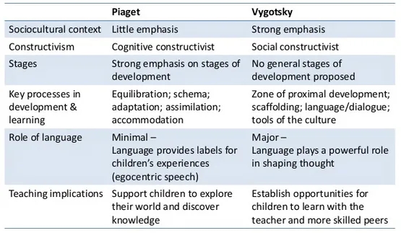
Vygotsky vs. Piaget’s Theories of Development
Constructivism is the theory that says learners construct knowledge rather than just passively take in information.
Notes:
Constructivism is the theory that says learners construct knowledge rather than just passively take in information. As people experience the world and reflect upon those experiences, they build their own representations and incorporate new information into their pre-existing knowledge (schemas).

Slide 29
TOOLS OF INTELLECTUAL ADAPTATION
Vygotsky claimed that infants are born with the basic abilities for intellectual development called 'elementary mental functions' (Piaget focuses on motor reflexes and sensory abilities):
Sensation
Perception
Memory
Eventually, through interaction within the sociocultural environment, these are developed into more sophisticated and effective mental processes which Vygotsky refers to as 'higher mental functions.'

Slide 30
Each culture provides its children tools of intellectual adaptation that allow them to use the basic mental functions more effectively/adaptively
Tools of intellectual adaptation is Vygotsky’s term for methods of thinking and problem-solving strategies that children internalize through social interactions with the more knowledgeable members of society.

Slide 31
Social Influences of Cognitive Development
Like Piaget, Vygotsky believes that young children are curious and actively involved in their own learning and the discovery and development of new understandings/schema. However, Vygotsky placed more emphasis on social contributions to the process of development, whereas Piaget emphasized self-initiated discovery.

Slide 32
The More Knowledgeable Other
The more knowledgeable other (MKO) is somewhat self-explanatory; it refers to someone who has a better understanding or a higher ability level than the learner, with respect to a particular task, process, or concept.
Although the implication is that the MKO is a teacher or an older adult, this is not necessarily the case. Many times, a child's peers or an adult's children may be the individuals with more knowledge or experience.
For example, who is more likely to know more about the newest teenage music groups, how to win at the most recent PlayStation game, or how to correctly perform the newest dance craze - a child or their parents?
Electronic tutors have also been used in educational settings to facilitate and guide students through the learning process. The key to MKOs is that they must have (or be programmed with) more knowledge about the topic being learned than the learner does.

Slide 33
Shaffer (1996) gives the example of a young girl who is given her first jigsaw. Alone, she performs poorly in attempting to solve the puzzle. The father then sits with her and describes or demonstrates some basic strategies, such as finding all the corner/edge pieces and provides a couple of pieces for the child to put together herself and offers encouragement when she does so.
As the child becomes more competent, the father allows the child to work more independently. According to Vygotsky, this type of social interaction involving cooperative or collaborative dialogue promotes cognitive development.

Slide 34
Zone of Proximal Development

Slide 35
Zone of Proximal Development
Vygotsky (1978) sees the Zone of Proximal Development as the area where the most sensitive instruction or guidance should be given - allowing the child to develop skills they will then use on their own - developing higher mental functions.
Vygotsky also views interaction with peers as an effective way of developing skills and strategies. He suggests that teachers use cooperative learning exercises where less competent children develop with help from more skillful peers - within the zone of proximal development.

Slide 36
Freund (1990) conducted a study in which children had to decide which items of furniture should be placed in particular areas of a dolls house.
Some children were allowed to play with their mother in a similar situation before they attempted it alone (zone of proximal development) while others were allowed to work on this by themselves (Piaget's discovery learning).
Freund found that those who had previously worked with their mother (ZPD) showed the greatest improvement compared with their first attempt at the task.
The conclusion being that guided learning through the ZPD led to greater understanding/performance than working alone (discovery learning).

Slide 37
Language plays two critical roles in cognitive development:
1: It is the main means by which adults transmit information to children.
2: Language itself becomes a very powerful tool of intellectual adaptation.
Vygotsky believed that language develops from social interactions, for communication purposes. Vygotsky viewed language as man’s greatest tool, a means for communicating with the outside world.

Slide 38
Three forms of language
Social speech which is external communication used to talk to others (typical from the age of two)
Private speech (typical from the age of three) which is directed to the self and serves an intellectual function
Private speech goes underground, diminishing in audibility as it takes on a self-regulating function and is transformed into silent inner speech (typical from the age of seven).

Slide 39
Children use private speech most often during intermediate difficulty tasks because they are attempting to self-regulate by verbally planning and organizing their thoughts (Winsler et al., 2007).
The frequency and content of private speech are then correlated with behavior or performance. For example, private speech appears to be functionally related to cognitive performance: It appears at times of difficulty with a task.

Slide 40
Children’s use of private speech diminishes as they grow older and follows a curvilinear trend as children are able to internalize language (through inner speech) in order to self-regulate their behavior (Vygotsky, 1987).
For example, research has shown that children’s private speech usually peaks at 3–4 years of age, decreases at 6–7 years of age, and gradually fades out to be mostly internalized by age 10 (Diaz, 1992).
Vygotsky proposed that private speech diminishes and disappears with age not because it becomes socialized, as Piaget suggested, but rather because it goes underground to constitute inner speech or verbal thought” (Frauenglass & Diaz, 1985).

Slide 41
Inner Speech - Function
For Vygotsky, thought and language are initially separate systems from the beginning of life, merging at around three years of age. At this point speech and thought become interdependent: thought becomes verbal, speech becomes representational. When this happens, children's monologues internalized to become inner speech. The internalization of language is important as it drives cognitive development.
'Inner speech is not the interior aspect of external speech - it is a function in itself. It still remains speech, i.e., thought connected with words. But while in external speech thought is embodied in words, in inner speech words dies as they bring forth thought. Inner speech is to a large extent thinking in pure meanings.'

Slide 42
CRITICISM
Perhaps the main criticism of Vygotsky's work concerns the assumption that it is relevant to all cultures.
Rogoff (1990) dismisses the idea that Vygotsky's ideas are culturally universal and instead states the concept of scaffolding - which is heavily dependent on verbal instruction - may not be equally useful in all cultures for all types of learning. Indeed, in some instances, observation and practice may be more effective ways of learning certain skills.

Slide 43
Good language knowledge is necessary to develop working memory, the executive function at the base of many cognitive operations, as it allows children to code external information to be then processed, stored, maintained, retrieved, and transformed into phonological and lexical representations for use in a range of different processing tasks.
Furthermore, the internal use of language, through self-reflection and self-questioning supports sustained and shifted attention, formation of rules and plans, and control of behavior during problem-solving activities

Slide 44
EPIGENETICS & CHILD DEVELOPMENT
Center on the Developing Child (2007). Epigenetics and Child Development: How Children’s Experiences Affect Their Genes. Retrieved from www.developingchild.harvard.edu.

Slide 45
“Epigenetics” is an emerging area of scientific research that shows how environmental influences—children’s experiences—actually affect the expression of their genes.
This means the old idea that genes are “set in stone” has been disproven.
Nature vs. Nurture is no longer a debate. It’s nearly always both!

Slide 46
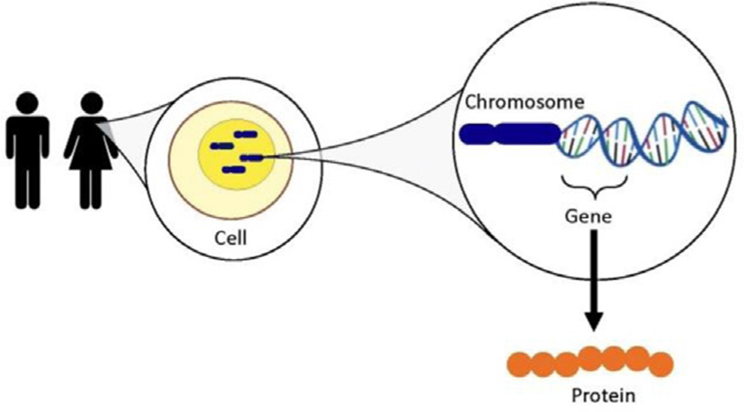
Chromosomes & Genes
Inside the nucleus of each cell in our bodies, we have chromosomes, which contain the code for characteristics that pass to the next generation.
Within these chromosomes, specific segments of genetic code, known as genes, make up long, double-helix strands of DNA and code for proteins..

Slide 47
The Epigenome
Children inherit approximately 23,000 genes from their parents, but not every gene does what it was designed to do.
Experiences leave a chemical “signature” on genes that determines whether and how the genes are expressed.
Collectively, those signatures are called the epigenome.
The different experiences children have rearrange those chemical marks. This explains why genetically identical twins can exhibit different behaviors, skills, health, and achievement.

Slide 48
Epigenetic Modification and the lifelong impact of early childhood experiences
The brain is particularly responsive to experiences and environments during early development.
External experiences spark signals between neurons, which respond by producing proteins.
These gene regulatory proteins head to the nucleus of the neural cell, where they either attract or repel enzymes that can attach them to the genes.
Positive experiences, such as exposure to rich learning opportunities, and negative influences, such as malnutrition or environmental toxins, can change the chemistry that encodes genes in brain cells — a change that can be temporary or permanent.

Slide 49
The epigenome can be affected by positive experiences, such as supportive relationships and opportunities for learning, or negative influences, such as environmental toxins or stressful life circumstances, which leave a unique epigenetic “signature” on the genes.
These signatures can be temporary or permanent and both types affect how easily the genes are switched on or off.
Recent research demonstrates that there may be ways to reverse certain negative changes and restore healthy functioning.
But the very best strategy is to support responsive relationships and reduce stress to build strong brains from the beginning.

Slide 50
Young brains are particularly sensitive to epigenetic changes
Experiences very early in life, when the brain is developing most rapidly, cause epigenetic adaptations that influence whether, when, and how genes release their instructions for building future capacity for health, skills, and resilience.
That’s why it’s crucial to provide supportive and nurturing experiences for young children in the earliest years.

Slide 51
Services such as high-quality health care for all pregnant women, infants, and toddlers, as well as support for new parents and caregivers can—quite literally— affect the chemistry around children’s genes.
Supportive relationships and rich learning experiences generate positive epigenetic signatures that activate genetic potential.

Slide 52
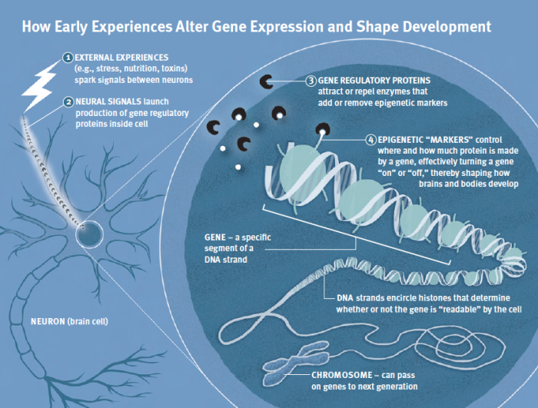

Slide 53
DEVELOPMENT OF EXECUTIVE FUNCTION SKILLS IN CHILDREN

Slide 54
The process of development is sometimes portrayed as one in which children gradually manage more and more aspects of their environments and lives on their own.
We would not trust two-year-olds to stop going after a ball just because it rolled into the street, get ready in the morning (brush their teeth, pick out their clothes, and get dressed) by themselves, or even clean up their toys without reminders.

Slide 55
Adults set up the framework (i.e., establishing routines, providing cues, breaking big tasks into smaller chunks) that helps children use the executive function skills they are developing to the best of their abilities.
We call these techniques “scaffolding.” Just as a scaffold supports workers while a building is being erected, adults can use these activities to support the emergence of children’s executive function skills until they can practice and perform them on their own. And, just as construction workers remove the scaffolding when the building itself can support them, over time we can reduce scaffolding activities and allow children to organize themselves and get their tasks done without constant reminders and direction.

Slide 56
EXECUTIVE FUNCTIONING SKILLS IN EARLY CHILDHOOD – SCIENTIFIC EVIDENCE
Executive function skills are crucial building blocks for the early development of both cognitive and social capacities.
Both normative differences in the nature and pace of individual developmental trajectories and the impacts of significant adversity will affect how the development of executive functioning will unfold for any given child
Several interventions focused on supporting the development of specific executive function skills have demonstrated at least short-term effectiveness, with evidence also emerging that they may have impacts on other aspects of learning as well.

Slide 57
As essential as they are, we aren’t born with the skills that enable us to control impulses, make plans, and stay focused.
We are born with the potential to develop these capacities—or not—depending on our experiences during infancy, throughout childhood, and into adolescence.
Our genes provide the blueprint, but the early environments in which children live leave a lasting signature on those genes.
This signature influences how or whether that genetic potential is expressed in the brain circuits that underlie the executive function capacities children will rely on throughout their lives.
These skills develop through practice and are strengthened by the experiences through which they are applied and honed.
Providing the support that children need to build these skills at home, in child care and preschool programs, and in other settings they experience regularly is one of society’s most important responsibilities.

Slide 58
Though executive functioning skills begin to emerge in infancy, a dramatic improvement in these capabilities occurs during the toddler and preschool periods, and these foundational skills provide the basis for future, more advanced cognitive, behavioral, and emotional regulation abilities.
Executive functioning deficits in early childhood have been shown to predict various problematic developmental outcomes, including poor academic achievement.

Slide 59
Early experiences within parent–child attachment relationships are believed to play a critical role in promoting the development of children’s self-regulatory capabilities.
During infancy, children depend on their parents as coregulatory partners to help with emotional, attentional, and behavioral modulation.
Parents who interact with their children in sensitive ways: interpreting their children’s signals and responding promptly and appropriately, help children regulate effectively .
Sensitive caregiving helps promote children’s budding self-control abilities by actively supporting children’s engagement with contextual challenges, avoiding excessive stimulation of children, and soothing children effectively when they are distressed.
During toddlerhood, sensitive caregiving involves remaining physically and psychologically available to children during experiences of anger or frustration, thereby helping regulate negative emotions.
As children become more independent through developmental advances in gross motor, cognitive, and language abilities, they take increasingly active roles in their own self-regulation.
It is thought that children who experience highly sensitive parenting internalize the effective regulation strategies they learn through co-regulation, leading to the development of strong self-regulatory capabilities over time.

Slide 60
Sensitive parenting has been observed to predict improved performance on executive functioning tasks later in development (Bernier, Beauchamp, Carlson, & Lalonde, 2015; Bernier, Carlson, & Whipple, 2010; Conway & Stifter, 2012; Moilanen, Shaw, Dishion, Gardner, & Wilson, 2010), and to buffer children from the harmful effects of early adverse experiences (Asok, Bernard, Roth, Rosen, & Dozier, 2013; Belsky & Fearon, 2002; Laucht, Esser, & Schmidt, 2001; Serbin, Hubert, Hastings, Stack, & Schwartzman, 2014).
The impact of parenting on executive functioning may have implications for other child outcomes as well, as executive functioning has been found to mediate the link between early insensitive parenting and children’s later externalizing problems and social difficulties (Bindman, Pomerantz, & Roisman, 2015; Conway et al., 2014; Low & Webster, 2015; Sulik et al., 2015).

Slide 61
Some attachment-based interventions designed for toddlers enhanced foster children’s executive functioning capabilities.
Foster children whose parents received these interventions demonstrated fewer attention problems and greater cognitive flexibility than children whose foster parents received a control intervention of identical intensity, duration, and in-home method of delivery.
In addition to increasing parents’ nurturing behaviors and responsiveness to children’s signals, these interventions also address the developmental issues encountered during toddlerhood and help parents remain psychologically and physically available when children are emotionally overwhelmed, thereby helping them serve as effective co-regulators.

Slide 62
INTERVENTIONS TO PROMOTE EXECUTIVE FUNCTION SKILLS
Center on the Developing Child at Harvard University (2014). Enhancing and Practicing Executive Function Skills with Children from Infancy to Adolescence. Retrieved from www.developingchild.harvard.edu.

Slide 63
Scaffolding is a technique used to help children learn new ideas beyond what they already know.
Think of a scaffold outside a building—it lets people reach heights they wouldn’t be able to reach on their own. Parents can do the same thing with their children.

Slide 64
How Do Parents Scaffold Their Baby’s Learning?
Pay attention to what your child is doing, wait and listen
At first, allow your child to experiment with something new on their own
If your child seems frustrated, offer to help
To help, make a very specific comment about the problem (“that puzzle piece is too big”) and a suggestion about the next step (“try putting a smaller piece in”)
Model new skills by showing your child how it is done
Help your child accomplish something by breaking the task up into small, easier steps

Slide 65
How Do Parents Scaffold Their Baby’s Learning 2
Support your child in doing each step (let them try on their own first)
Fix problems or mistakes without pointing them out
Don’t finish the task for your child
Give lots of specific praise for your child’s effort (“You worked really hard”)
Help your child to feel pride in their work (“You must feel so proud that you stacked three blocks!”)

Slide 66
EXECUTIVE FUNCTION ACTIVITIES FOR 6- TO 18- MONTH OLDS

Slide 67
These activities encourage infants to focus attention, use working memory, and practice basic self-control skills.
During this stage of development, infants are actively developing their core executive function and self-regulation (EF/SR) skills.
Supportive, responsive interactions with adults are the foundation for the healthy development of these skills.
However, particular activities can strengthen key components of EF/SR.
In using these activities, adults should attend to the infant’s interests and select activities that are enjoyable, while also allowing the infant to determine how long to play

Slide 68
LAP GAMES FOR YOUNGER INFANTS
Generations of families have engaged babies in games while holding them in the lap. Different games practice different skills, but all are predictable and include some basic rules that guide adult and child behavior. Repetition helps infants remember and manage their own behavior to fit the game’s rules.
Peekaboo — Hide-and-find games like this exercise working memory, because they challenge the baby to remember who is hiding, and they also practice basic self-control skills as, in some variations, the baby waits for the adult to reveal him or herself. In other versions, the baby controls the timing of the reveal; this provides important practice regulating the tension around an expected surprise.
Trot, Trot to Boston; This is the Way the Farmer Rides; Pat-a-Cake — Predictable rhymes that end with a stimulating yet expected surprise are widely used. Infants exercise working memory as they develop familiarity with the rhyme and practice anticipating a surprise, inhibiting their anticipatory reactions while managing high levels of stimulation.

Slide 69
HIDDING GAMES
Hiding games are a great way to challenge working memory.
Hide a toy under a cloth and encourage the infant to look for it. Once infants can find the toy quickly, hide it, show the child that you have moved it, and encourage the child to find it. Make more moves to increase the challenge. As the child remembers what was there and mentally tracks the move, he or she exercises working memory.
Older infants may enjoy hiding themselves and listening to you search loudly for them while they track your location mentally.
You can also hide an object without showing an older infant where it is and then allow the infant to search for it. He or she will practice keeping track of searched locations.
Another challenging version of these games involves putting a set of cups on a turntable (or “lazy Susan”), hiding an object under a cup, then spinning the turntable. Hiding more than one object can also increase the challenge.

Slide 70
IMITATION OR COPYING GAMES
Infants love to copy adults. When they imitate, they have to keep track of your actions, remember them, wait their turn, and then recall what you did. In doing so, they practice attention, working memory, and self-control.
These games have a variety of forms, from taking turns making simple gestures (e.g., waving) to organizing toys in certain ways and asking children to copy you (e.g., placing toy animals in a barnyard) or building simple buildings by putting one block on top of another and perhaps knocking them down to rebuild.
As infants’ skills improve, make the patterns they copy more complicated.
Adults can also demonstrate ways to play with toys, like making a toy horse gallop or rocking a baby doll. This introduces the concept of using toys as symbols for real objects.

Slide 71
SIMPLE ROLE PLAY
Older children in this age range enjoy doing the tasks they see you do.
Take turns with any activity that interests the child, such as sweeping the floor, picking up toys, dusting, etc. These games introduce the basics of imaginary play and practice working memory, self-control, and selective attention, because the toddler must hold the activity in mind to complete it while avoiding distractions and inhibiting the impulse to do other things.
Children can remember and play out more complicated roles as they get older. They will also begin to initiate activities. Providing the necessary materials (e.g., a broom, a toy box, a dust cloth) can help children enjoy and sustain this type of play.

Slide 72
FINGERPLAYS
Songs or chants with simple hand motions are a lot of fun for infants, and develop self-control and working memory as well as language. Infants can learn to copy the movements to a song and, with practice, will remember the sequence. Eensy Weensy Spider; Where is Thumbkin?; and Open, Shut Them are examples, but these fingerplays can be found in many languages and cultures.

Slide 73
CONVERSATIONS
Simply talking with an infant is a wonderful way to build attention, working memory, and self-control.
With younger infants, start by following the infant’s attention and naming aloud the things holding his or her attention. The infant will likely maintain his or her attention a little longer, practicing actively focusing and sustaining attention.
As infants get older, pointing out and talking about interesting objects or events can help them learn to focus their attention on something the adult has identified. As babies learn language, they also develop their memory of what is said, eventually mapping words to objects and actions. n Conversations in any language besides English are also helpful. It has been found that bilingual children of many ages have better executive function skills than monolingual children, so experience using an additional language is an important skill.

Slide 74
RESOURCES
Songs and games
www.piercecountylibrary.org/files/library/wigglesticklesall.pdf n
www.turben.com/media-library/8702756_infanttoddlerplaybook.pdf
www.zerotothree.org/child-development/grandparents/play-0-12-mths-final.pdf

Slide 75
EXECUTIVE FUNCTION ACTIVITIES FOR 18- TO 36- MONTH OLDS

Slide 76
During this stage of development, children are rapidly expanding their language skills.
Language plays a pivotal role in the development of executive function and self-regulation (EF/SR), as it helps children identify their thoughts and actions, reflect on them, and make plans that they hold in mind and use.
Language also helps children understand and follow increasingly complex rules—both those that regulate behavior and those that apply to simple games.
Additionally, bilingualism is associated with better EF/SR, so parents who are fluent in more than one language should use those languages with their children.

Slide 77
ACTIVE GAMES
At this age, toddlers are actively developing many important physical skills, and they love physical challenges. The following activities require toddlers to focus and sustain their attention on a goal, inhibit unnecessary and ineffective actions, and try things in new ways if a first attempt fails. They may not always succeed, but the practice is very important. This is a learning process. Many of these activities will require frequent reminders from adult organizers, and they may not last very long!

Slide 78
Provide many materials and opportunities to try new skills, such as throwing and catching balls, walking a balance beam, running up and down an incline, jumping, etc. Set up simple rules to follow for added working memory and inhibition challenges—for example, take turns running to a “finish line” and back.
Older toddlers can enjoy simple imitation games, such as Follow the Leader, or song games like Punchinella or Follow, Follow (“Follow, follow, follow [child’s name], follow, follow, follow [child’s name]”—all children imitate [child]). These are great tests of working memory as well as attention and inhibition.

Slide 79
Games that require active inhibition can be fun, too, like freeze dance (musical statues), although don’t expect children to “freeze” without a few reminders. Also effective are song games that require children to start and stop, or slow down and speed up, such as Jack in the Box; Popcorn; Ring Around the Rosie; or Motorboat, Motor
Song games with many movements are also fun. Examples include The Hokey Pokey; Teddy Bear; I’m a Little Teapot; or Head, Shoulders, Knees, and Toes. These require children to attend to the song’s words and hold them in working memory, using the song to guide their actions.

Slide 80
CONVERSATION AND STORYTELLING
As children develop more spoken language skills, they can begin to engage actively in conversation with adults and tell simple stories.
Simply watching and narrating their play can be a great way to help very young children understand how language can describe their actions. As children get older, questions can be added, such as “What will you do next?” or “I see you want to put the ball inside the jar. Is there another way to do that?” These comments help children pause to reflect on what they are trying to do, how what they have tried has worked, and how to plan their next move.

Slide 81
Telling stories about shared events can be a great way to reflect on these experiences. The experience must be held in working memory while the child considers the order in which things happened, why things happened the way they did, and what the experience meant. These stories can also be written or drawn into simple books and revisited.
Talking about feelings is also important, either by labeling children’s feelings as they are noticed (“It looks like you are really angry right now”) or by telling the story of a time a child became upset. By giving children language to reflect on their feelings, these conversations can support the development of emotional regulation, which is essential for engaging executive function.

Slide 82
MATCHING/SORTING GAMES
Children this age are able to play simple matching and sorting games, which require children to understand the rule that organizes the activity (sorting by shape, color, size, etc.), hold the rule in mind, and follow it.
Ask children to play a sorting game in which you take turns sorting objects by size, shape, or color.

Slide 83
Engage older toddlers in a silly sorting game, such as putting small shapes in a big bucket and big shapes in a small bucket. Children tend to put like with like, so a change is challenging, requiring them to inhibit the expected action and engage their selective attention and working memory.
As they get older, toddlers also start to enjoy simple puzzles, which require attention to shapes and colors. Adults can ask children to think about what shape or color they need, where they might put a certain piece, or where they might put the piece if it doesn’t fit, thereby exercising the child’s reflection and planning skills.

Slide 84
IMAGINARY PLAY
Toddlers are beginning to develop the capacity for simple imaginary play. Often, toddlers imitate adult actions using objects that they have available (such as sweeping with a broom or pretending to cook with a pot). When they reach this age, these actions are not simply imitative, but can be sustained and show signs of simple imaginary play plots. For example, after “cooking” in the pot, the child will put the pot on the table and pretend to eat.

Slide 85
Ask children questions about what they are doing. Narrate the things you see happening.
Play along with the child, and let the child direct the play. Give the child a chance to tell you what role you should play and how you should do it. Regulating the behavior of others is an important way that children develop their own self-regulation skills.
Provide a variety of familiar household objects, toys, and clothing items to encourage children’s imaginary play.

Slide 86
RESOURCES
Music
fun.familyeducation.com/toddler/music/37371.html
Other activities
www.zerotothree.org/child-development/ grandparents/play-12-24-final.pdf n www.zerotothree.org/child-development/ grandparents/play-24-36-final.pdf
Pretend play suggestions
www.mindinthemaking.org/wp-content/ uploads/2014/10/PFL-playing-with-householditems.pdf

Slide 87
EXECUTIVE FUNCTION ACTIVITIES FOR 3- TO 5- YEAR OLDS
Children’s executive function and self-regulation skills grow at a fast pace during this period, so it is important to adapt activities to match the skills of each child. Younger children need a lot of support in learning rules and structures, while older children can be more independent. Ultimately, the goal is to shift children away from relying on adult regulation, so when the child seems ready, try to reduce the support you provide.

Slide 88
IMAGINARY PLAY
During intentional imaginary play, children develop rules to guide their actions in playing roles. They also hold complex ideas in mind and shape their actions to follow these rules, inhibiting impulses or actions that don’t fit the “role.”
Players often take ideas from their own lives, such as going to the doctor’s office. They might act “sick,” be examined by the doctor, and receive a shot. The “doctor” talks and acts like a doctor (calm and reassuring), the “sick child” talks and acts like a sick child (sad and scared), and the child in the role of “parent” talks and acts like a concerned parent (worried and caring).
While younger children tend to play alone or in parallel, children in this age range are learning to play cooperatively and often regulate each other’s behavior—an important step in developing self-regulation.

Slide 89
Ways to support high-level imaginary play
Read books, go on field trips, and use videos to make sure that children know enough about the scenario and roles to support pretend play.
Provide a varied set of props and toys to encourage this type of play. Younger preschoolers may need more realistic props to get the play started (e.g., toy medical kits), while older children can re-purpose other things to turn them into play props (e.g., paper towel tube that is used as a cast for a “broken arm”). Reusing familiar objects in a new way also practices cognitive flexibility.

Slide 90
Allow children to make their own play props. Children must determine what is needed, hold this information in mind, and then follow through without getting distracted. They also exercise selective attention, working memory, and planning. If the original plans don’t work out, children need to adjust their ideas and try again, challenging their cognitive flexibility.
Play plans can be a good way to organize play, as shown by one early education program designed to build self-regulation, Tools of the Mind. Children decide who they are going to be and what they are going to do before they start playing, and then draw their plan on paper. Planning means that children think first and then act, thus practicing inhibitory control. Planning play in a group also encourages children to plan together, hold these plans in mind, and apply them during the activity. It encourages social problem solving, as well as oral language.

Slide 91
STORYTELLING
Children love to tell stories. Their early stories tend to be a series of events, each one related to the one before, but lacking any larger structure. With practice, children develop more complex and organized plots. As the complexity of the storytelling grows, children practice holding and manipulating information in working memory.

Slide 92
Ways to support storytelling
Encourage children to tell you stories, and write them down to read with the child. Children can also make pictures and create their own books. Revisiting the story, either by reviewing pictures or words, supports more intentional organization and greater elaboration.
Tell group stories. One child starts the story, and each person in the group adds something to it. Children need to pay attention to each other, reflect on possible plot twists, and tailor their additions to fit the plot, thereby challenging their attention, working memory, and self-control.
Have children act out stories they have written. The story provides a structure that guides children’s actions and requires them to attend to the story and follow it, while inhibiting their impulse to create a new plot.
Bilingual families can tell stories in their home language. Research indicates that bilingualism can benefit a variety of executive function skills in children of all ages, so fostering fluency in a second language is valuable.

Slide 93
MOVEMENT CHALLENGES: SONGS AND GAMES
The demands of songs and movement games support executive function because children have to move to a specific rhythm and synchronize words to actions and the music. All of these tasks contribute to inhibitory control and working memory. It is important that these songs and games become increasingly complex to interest and challenge children as they develop more self-regulation skills.
Provide many opportunities for children to test themselves physically through access to materials such as climbing structures, balance beams, seesaws, etc. Setting challenges for children—such as obstacle courses and games that encourage complex motions (skipping, balancing, etc.)—can also be fun. When children are trying new and difficult activities, they need to focus attention, monitor and adjust their actions, and persist to achieve a goal.

Slide 94
Encourage attention control through quieter activities that require children to reduce stimulation and focus attention—such as using a balance beam or yoga poses that include slow breathing.
Play some music and have children dance really fast, then really slowly. Freeze dance is also fun, and it can be made more difficult by asking children to freeze in particular positions. (Tools of the Mind uses stick-figure pictures to direct children.) When the music stops, children must inhibit action and shift their attention to the picture to imitate the shape depicted.
Songs that repeat and add on to earlier sections (either through words or motions) are a great challenge to working memory, such as the motions to She’ll Be Coming ’Round the Mountain, the words to Bought Me a Cat, and backward-counting songs, such as Five Green and Speckled Frogs and songs repeating a long list (the Alphabet Song).
Traditional song games, like Circle ’Round the Zero are also fun. Complex actions, including finding partners, must be accomplished without becoming distracted.

Slide 95
QUIET GAMES AND OTHER ACTIVITIES
Matching and sorting activities are still fun, but now children can be asked to sort by different rules, promoting cognitive flexibility. Children can first sort or match by one rule (such as by color), and then immediately switch to a new rule (such as by shape). For a more challenging version, play a matching game, but change the rule for each pair. Quirkle and S’Match are commercially available games that challenge cognitive flexibility in this way. Or play a bingo or lotto game, in which children have to mark a card with the opposite of what is called out by the leader (e.g., for “day,” putting a chip on a nighttime picture). Children have to inhibit the tendency to mark the picture that matches, while also remembering the game’s rule.
Increasingly complicated puzzles can engage children this age, exercising their visual working memory and planning skills.
Cooking is also a lot of fun for young children. They practice inhibition when waiting for instructions, working memory while holding complicated directions in mind, and focused attention when measuring and counting.

Slide 96
RESOURCES
Pretend play suggestions
www.mindinthemaking.org/ wp-content/uploads/2014/10/ PFL-4-year-old-independentplay.pdf
Montessori activities – Walking on the line
www.infomontessori.com/ practical-life/control-of-movement-walking-on-the-line.htm
Songs
kids.niehs.nih.gov/games/ songs/childrens/index.htm

Slide 97
QUESTIONS?

